Slide 1
CAN Protocol-Overview
ADAS-EEP-Boot Loader

Slide 2
Session Objectives
To understand the characteristics and working principles of CAN protocol

Slide 3
Session Topics
Introduction
Classification
Standards Covered
Properties and CAN Frame Structure
Types of Frames
Fault Confinement
Bit Timing Requirements
Synchronization
CAN-FD-char, frame structure
Can- ISO OSI Reference Model
PCS82C250
References

Slide 4
CAN Protocol

Slide 5
Introduction
The goal was to make automobiles more reliable, safe and fuel efficient while decreasing wiring harness weight and complexity
What is Can?
CAN is a serial communication protocol with a bit rate up to 1Mbps.

Slide 6
Classification of Vehicle Buses
Class A
Power windows, door locks, power seats, mirror control, wiper
Required data rates up to 125 kbps
Eg: Local Interconnect Network (LIN)
Class B
Cruise control, HVAC, drive train, tire pressure
Required data rates up to 1 Mbps
Eg: Controller Area Network (CAN)
Class C
Brake control, ABS, engine control, suspension control
Real-time operation, required data rates of up to 10 Mbps – Flexray
Class D
Multimedia applications, navigation systems, audio, video
Required data rates of 10 Mbps or faster
Eg: Media Oriented System Transport (MOST)

Slide 7
Standards Covered
2.0A sometimes known as Basic or Standard CAN with 11 bit message identifiers which was originally specified to operated at a maximum frequency of 250 kbps and is ISO11519.
2.0B known as Full CAN or extended frame CAN with 29 bit message identifier which can be used at up to 1 mbps and is ISO 11898.
CAN FD increases the max data throughput to 3.7 mbps .

Slide 8
Properties
Multi master
The whole point is that you don't need a single master or main controller to take care of everything. So there are no slaves.
If there was a single main controller, and if it fails, then the entire network will fail. So the concept of multi master is to reduce failure points.
Maximum Signal frequency used is 1 mbps (CAN 2.0) , 15 mbps (CAN FD)
Typical maximum data rate achievable is 320 kbps for CAN 2.0 and 3.7 mbps for CAN FD
Message Oriented
When a bus is free any node can start to transmit the message. The content of the message is named by an identifier. The identifier describes the meaning of the data. It does not contain the destination.

Slide 9
In other words, every message is transmitted to all the nodes in the network, but whether the data is to be acted upon by them or not is determined by the nodes.
This is done by MESSAGE FILTERING.
Messages can be accepted by all nodes or no node. So there is data consistency.
Any number of nodes can be added or removed, because nodes do not make use of configuration details.
Arbitration
If two or more units start transmitting messages at the same time, the bus access conflicts are resolved by bitwise arbitration using the IDENTIFIER.
During arbitration every transmitter compares the level of the bit transmitted with the level that is monitored on the bus.
If these levels are equal the unit may continue to send.
Else, the unit has lost arbitration and must withdraw without sending one more bit

Slide 10
Length depends on the bit rate typical values encountered in the field for CAN 2.0 are
1 mbps 40 m
500 kbps 110 m
250 kbps 240 m
125 kbps 500 m
50 kbps 1.3 km
20 kbps 3.3 km
10 kbps 6.6 km
5 kbps 130 km

Slide 11
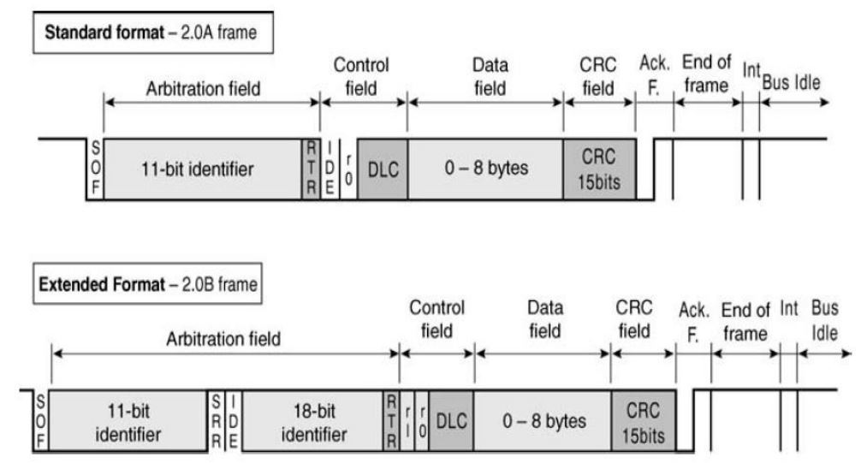
CAN FRAME STRUCTURE

Slide 12
CAN Frame
SOF
Start of Frame
Bus Idle
0
Arbitration Field
It indicates the beginning of data/remote frames.
It is a single dominant bit.
All receiver nodes has to be synchronized to leading edge of SOF of the transmitter node.

Slide 13
CAN Frame
Arbitration
Field
Standard Frame
Bus Idle
SOF
11-bit Identifier
RTR
Control Field
The ARBITRATION FIELD consists of the IDENTIFIER and the RTR-BIT.
The IDENTIFIER’s length is 11 bits. The least significant bit is ID-0. The 7 most significant bits (ID-10 - ID-4) must not be all ’recessive’.
In DATA FRAMEs the RTR(Remote Transmission Request) BIT has to be ’dominant’. Within a REMOTE FRAME the RTR BIT has to be ’recessive’.

Slide 14
CAN Frame
Arbitration
Field
Extended Frame
Bus Idle
SOF
11-bit Identifier
RTR
Control Field
The ARBITRATION FIELD consists of the IDENTIFIER and the RTR-BIT.
The IDENTIFIER’s length is 29 bits. The least significant bit is ID-0. The 7 most significant bits (ID-10 - ID-4) must not be all ’recessive’.
In DATA FRAMEs the RTR(Remote Transmission Request) BIT has to be ’dominant’. Within a REMOTE FRAME the SRR(Substitute Remote Request) BIT has to be ’recessive’.

Slide 15
CAN Frame
Control Field
11-bit Identifier
RTR
IDE
DLC 0
DLC 1
DLC 2
DLC 3
Data Field
The CONTROL FIELD consists of six bits. It includes the DATA LENGTH CODE (4 bits) and two bits reserved for future expansion(Basic CAN).
The number of bytes in the DATA FIELD is indicated by the DATA LENGTH CODE.
All receiver nodes has to be synchronized to leading edge of SOF of the transmitter node.
Identifier Extension (IDE) bit is dominant for Standard Frames and recessive for Extended Frames

Slide 16
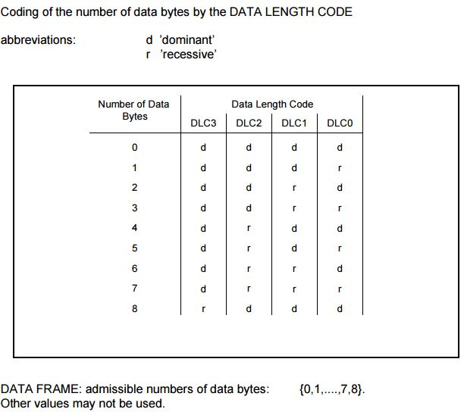
DLC for Standard CAN

Slide 17
CAN Frame
Data
Field
Control Field
Data Field
CRC Field
The DATA FIELD consists of the data to be transferred within a DATA FRAME .
It contains 8 bytes(64 bits) transferred MSB first.
0 bytes will be transferred to indicate an event.

Slide 18
CAN Frame
CRC
Field
Data Field
CRC Field
DEL
Acknowledge Field
The message string is treated as a single word M.
It is divided by a keyword K. In Standard CAN it is
Let the remainder be R. Now R and M are sent to the receiver.
The receiver can repeat the process, get a remainder and check with R.
The CRC delimiter is always recessive and indicates end of CRC field.

Slide 19
CAN Frame
Acknowledge
Field
CRC Field
ACK
DEL
EOF Field
The ACK FIELD is two bits long and contains the ACK SLOT and the ACK DELIMITER. In the ACK FIELD the transmitting station sends two recessive bits.
The receiver sends a dominant bit in ACK slot if the message is valid(i.e., if CRC matches).
The ACK DELIMITER is the second bit of the ACK FIELD and has to be a recessive bit.

Slide 20
CAN Frame
End Of Frame
(EOF) Field
ACK Field
1
1
1
1
1
1
1
Inter frame
Each DATA FRAME and REMOTE FRAME is delimited by a flag sequence consisting of seven ’recessive’ bits.
It is followed by Inter Frame Space

Slide 21
Types of Frames
DATA
FRAME
REMOTE
FRAME
ERROR
FRAME
OVERLOAD
FRAME
INTER
FRAME
SPACE

Slide 22
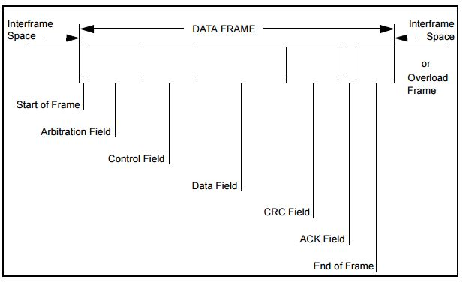
Data Frame

Slide 23
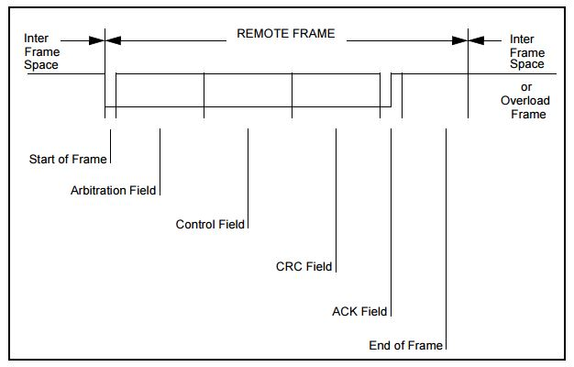
Remote Frame

Slide 24
Remote Frame
For certain data, in order to initiate transmission, a receiver node can send remote data.
There are two things to note here
There is no data field.
The RTR bit is recessive.
Note that, it is independent of the DLC.

Slide 25
Error Frame
When an error is detected error frame is sent.
This leads to the different types of errors.
Types of error
There are five types of error are there in CAN and are listed below.
And in case, any one of these error is observed the error frame is transmitted.

Slide 26
Bit error: During transmission the node transmits the bit at transmit time region and receives the bit at receive time and two bits are compared if they are not equal then that is considered as bit error.
Stuff error: In a frame if continuous 5 recessive or dominant bits are transmitted, the sixth bit should be of opposite to that.
While receiving if continuous 5 recessive or dominant bits are received then the next incoming bit is of same value that of previous then it will be considered as stuff error.
Bit Stuffing rule does not apply to CRC delimiter, ACK field and EOF. These fields are fixed.

Slide 27
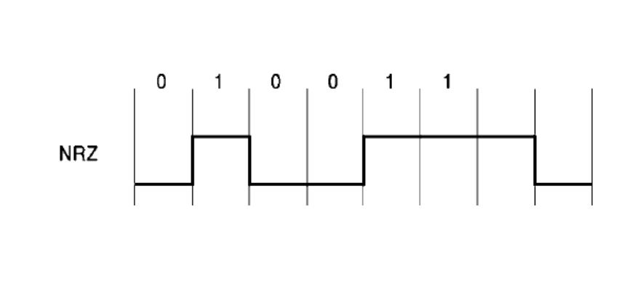
Bit Stuff and NRZ Coding
Bit stream is coded according to NRZ Coding

Slide 28
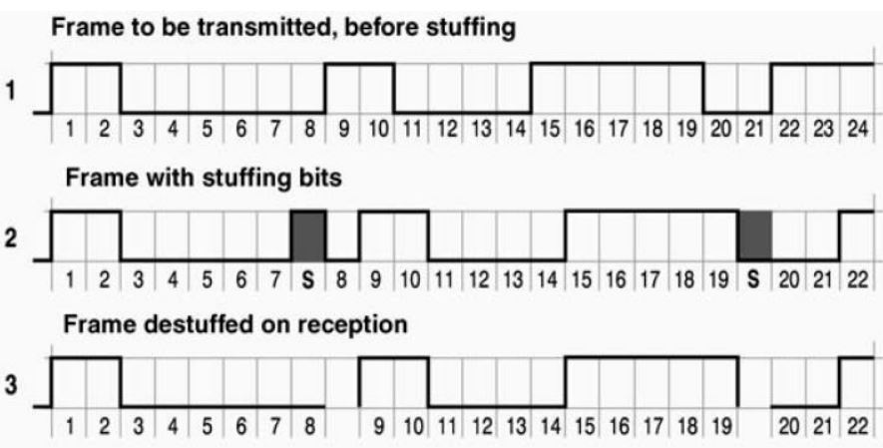
Bit Stuffing- Example

Slide 29
Types of Errors
CRC error: While receiving data or remote frame the CRC value will be calculated and is compared with the received CRC values.
In case of proper frame transmission both will be equal. Else that will be considered as CRC error and error frame will be transmitted.
Form error: Form error will be related to the error in forming the frame.
For e.g. delimiter (CRC, ACK) missing or improper end of frame, these conditions are taken as form error and immediately error frame is transmitted.
Acknowledgement error: During the transmission of data or remote frame, in the ACK flag field the transmitter will put recessive bit and expect dominant bit from receive pin.
If dominant bit is observed then that is considered as proper transmission. In other case it is acknowledgement error.
The error frame is transmitted if acknowledgment error is observed.

Slide 30
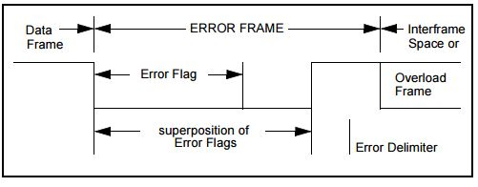
Error Frame
The ERROR FRAME consists of two different fields. Error Flag and Error Delimiter.
There are two forms of error flag: Active Error Flag (6 consecutive dominant flags) and Passive Error Flag(6 consecutive recessive flags).
So when six 0’s/1’s are being transmitted, it violates bit stuffing rule and as a consequence all the nodes will send a error flag. Error flag can vary from 6 to 12 bits.
After transmission of an ERROR FLAG each station sends recessive bits and monitors the bus until it detects a recessive bit. Afterwards it starts transmitting seven more recessive bits.

Slide 31
Overload Frame
Overload frames are sent when the receiver is not able to receive frames and requires delay.
Originally introduced to gain more time for processing the received data, today no CAN controller sends them actively.
All CAN controllers are fast enough to store the received data.
Nevertheless, the CAN protocols specify some conditions where an Overload Frame needs to be transmitted.
It has the same structure and format as an active Error Flag.
However, it doesn’t cause an increase of the error counters or an automatic retransmission of the message.

Slide 32
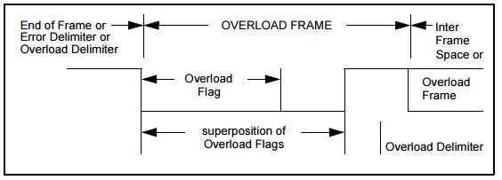
Overload Frame
A overload frame is received during the inter frame space and the error frame is received during the actual CAN frame. Moreover it does not increse the TEC/REC count This is how the CAN controller distinguishes between an error frame and an overload frame.
It consists of overload flag(dominant 6 bits) and overload delimiter (recessive 8 bits).

Slide 33
Inter Frame Space
Preceding frames are separated from each other with Inter frame spaces.
OVERLOAD FRAMEs and ERROR FRAMEs are not preceded by an INTERFRAME SPACE and multiple OVERLOAD FRAMEs are not separated by an INTERFRAME SPACE.

Slide 34
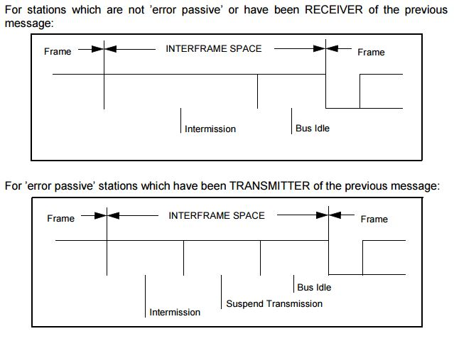
Inter frame Space

Slide 35
Inter frame Space
Intermission- During this time, no nodes are allowed to transmit.
Bus Idle- Bus idle is a arbitrary period till a node starts to transmit.
Suspend Transmission- After a error passive message is transmitted, the corresponding node sends 8 recessive bits followed by Intermission.

Slide 36
Fault Confinement
For fault confinement two counts are implemented in every bus unit:
TRANSMIT ERROR COUNT :When a TRANSMITTER sends an ERROR FLAG the TRANSMIT ERROR COUNT is increased by 8.
RECEIVE ERROR COUNT : When a RECEIVER detects an error, the RECEIVE ERROR COUNT will be increased by 1.
If a RECEIVER detects a bit error after sending a active error flag or an overload flag, the RECEIVE ERROR COUNT will be increased by 8.

Slide 37
Fault Confinement
A node can have three states.
Error active
Error Passive
Bus off
Let's assume that whenever node-A (for example) on a bus tries to transmit a message, it fails (for whatever reason).
Each time this happens, it increases its Transmit Error Counter by 8 and transmits an Active Error Flag. Then it will attempt to retransmit the message and suppose the same thing happens again.
When the Transmit Error Counter rises above 127 (i.e. after 16 attempts), node A goes Error Passive. It will now transmit passive error flags on the bus.

Slide 38
Cont.,
A Passive Error Flag comprises 6 recessive bits, and will not destroy other bus traffic - so the other nodes will not hear the node-A complaining about bus errors.
However, A continues to increase its TEC. When it rises above 255, node-A finally stops and goes to "Bus Off" state.
For every active error flag that A transmitted, the other nodes will increase their Receive Error Counters by 1. By the time that A goes Bus Off, the other nodes will have a count in their Receive Error Counters that is well below the limit for Error Passive, i.e. 127.
This count will decrease by one for every correctly received message. However, node A will stay bus off.
The TEC will decrease by 1 for every correctly transmitted message. When this count reduces below 127, it sets the node to send active error flag.
A bus-off node can become error active node after 128 occurrence of 11 recessive bits that is monitored on the bus.
Note: Most CAN controllers will provide status bits and corresponding interrupts for two states: "Error Warning" (for one or both error counters are above 96) and "Bus Off".

Slide 39
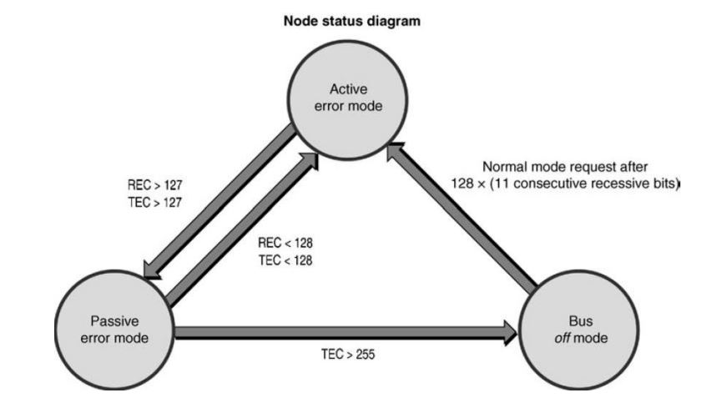
Fault Confinement

Slide 40
Bit Timing Requirements
Each bit in a CAN message frame is made up of four non- over laping time segments.
They are:
Synchronization Segment
Propagation Segment
Phase Segment 1
Phase Segment 2
The Sample point will always be at the end of Phase-seg1. It is the time at which the bus level is read and interpreted as the value of the current bit.
What is quantum?
The period of the local oscillator (or the system clock period) multiplied by the value of BRP(Baud Rate Prescalar) register , normally 1 to 32, is called one quantum.
Total programmable time quanta is from 8 to 25

Slide 41
Bit time
Bit time
1 Bit
The bit time t_{Bit} is the time it takes to transmit one bit.
Example: Data rate: f = 500 kBit / s
➔ Bit time: t_{Bit} = 2 μs

Slide 42
Time quantum
Bit time
1 Bit
t_{q}
The bit time is divided up into time quanta t_{q}.

Slide 43
Bit time segments
Bit time
t_{q}
Sync_Seg
Synchronization Segment
Prop_Seg
Propagation Time Segment
Phase_Seg1
Phase Buffer Segment 1
Phase_Seg2
Phase Buffer Segment 2

Slide 44
Bit Timing Requirements
Synchronization Segment
Used to synchronize the nodes in the bus
One quantum long
A bit edge is expected to take place during this synchronization segment when the data changes on the bus.
Propagation Segment
Used to compensate for physical delay times within the bus
It is programmable from 1 to 8 quant long
Phase Segment 1
This is a buffer segment that can be lengthened during resynchronization to compensate for oscillator drift and positive phase differences between the oscillators of the transmitting and receiving nodes.
It is programmable from one to eight time quanta long.
Phase Segment 2
This is a buffer segment that can be shortened during resynchronization to compensate for oscillator drift and negative phase differences between the oscillators of the transmitting and receiving nodes.
It is Phase Segment 1 + Information Processing time long( It is the time segment starting from Sample point and is less than or equal to 2 quanta).

Slide 45
Synchronization
So if a node is a receiver, it has to synchronize itself with the transmitter. How does it synchronizes?
There are two ways of synchronization
Hard Synchronization
It occurs at the Start-of-Frame or at the transition of the start bit.
The bit time is restarted from that edge.
Resynchronization
If there is oscillator drift and phase differences between transmitter and receiver oscillators, additional synchronization is needed to compensate them.
A bit edge is expected to take place during this synchronization segment when the data changes on the bus. If that does not happen, resynchronization is required.
How it happens is, one of the phase segments are either shortened or lengthened depending upon the phase error.
How much we can shorten or lengthen depends upon the Synchronization Jump Width parameter (SJW).

Slide 46
Adjustable controller parameters
TSEG1
TSEG2
TSEG1
TSEG2
BRP
SJW
Time Segment 1
TSEG1 = Prop_Seg + Phase_Seg1
Time Segment 2
TSEG2 = Phase_Seg2
Baud Rate Prescaler
Synchronization Jump Width
SJW indicates the maximum number of time quanta t_{q}
by which TSEG1 may be lengthened or TSEG2 may be shortened.

Slide 47
Bit lengthening
tq
Needed Sample
Point
Next
sync.seg.
Transmitter-slower
Next edge for Re- synchronization delayed by 1tq
Next
sync.seg.
Receiver-faster
Needed Sample
Point
Needed Sample
Point
Next
sync.seg.
Transmitter-slower
Phase Buffer Segment 1 lengthened by 1tq
Next
sync.seg.
Receiver-faster
Needed Sample
Point
Sync_Seg
Synchronization Segment
Prop_Seg
Propagation Time Segment
Phase_Seg1
Phase Buffer Segment 1
Phase_Seg2
Phase Buffer Segment 2

Slide 48
Bit Shortening
Receiver-slower
Bit N
Bit N+1
Needed Sample
Point
Next
sync.seg.
Transmitter-faster
Next edge for Re- synchronization delayed by 1tq too early
Next
sync.seg.
Needed Sample
Point
Phase Buffer Segment 2 shortened by 1 tq
Next
sync.seg.
Needed Sample
Point
Receiver-slower
Transmitter-faster
Next
sync.seg.
Needed Sample
Point
Sync_Seg
Synchronization Segment
Prop_Seg
Propagation Time Segment
Phase_Seg1
Phase Buffer Segment 1
Phase_Seg2
Phase Buffer Segment 2

Slide 49
Resynchronization
Phase error(e) is given by the position of the error with respect to the synchronization segment.
If the edge lies before the sample point, e is positive. If e is positive, Phase Segment 1 is lengthened by the amount equal to resynchronization jump width.
If the edge lies after the sample point, e is negative. If e is negative, Phase Segment 2 is shortened by the amount equal to resynchronization jump width.

Slide 50
CAN with Flexible Data Rate

Slide 51
Characteristics
Allows data rate up to 15Mbps.
Allows payloads up to 64 bytes per frame.
It has longer CRC polynomials
It is compatible with CAN 2.0 A and 2.0 B
There is no remote frame. But it can transmit a remote frame in CAN format.
There are two frame formats: CAN FD Base Format-11 bit identifier and CAN FD Extended Format-29 bit identifier.

Slide 52
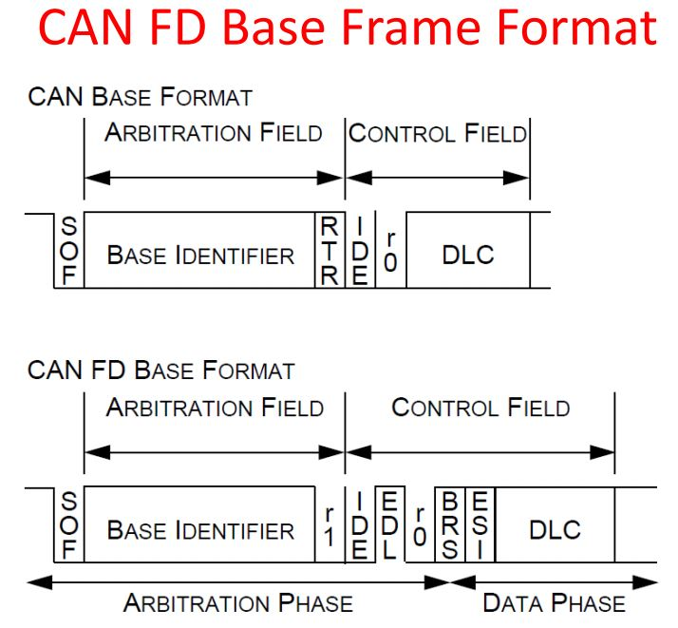
CAN FD BASE FRAME STRUCTURE

Slide 53
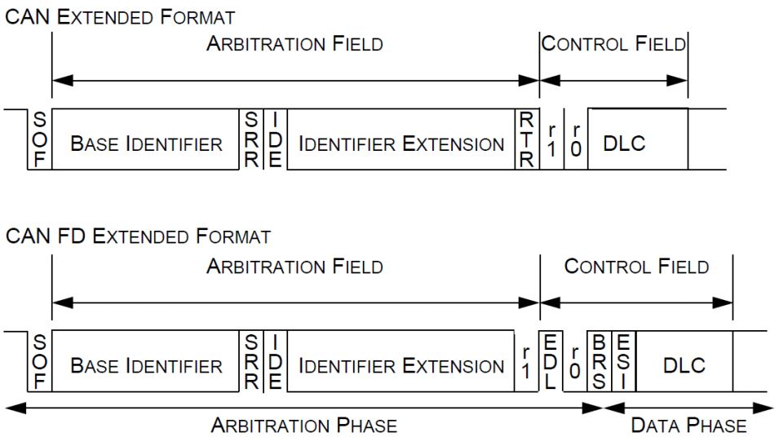
CAN FD EXTENDED FRAME STRUCTURE

Slide 54
CAN FD CONTROL FIELD
IDE: Identifier Extension
EDL: Extended data Length-distinguishes between CAN and CAN FD
BRS: Bit Rate Switch.
If it is recessive then bit rate is switched from standard bit rate to preconfigured bit rate.
If it is dominant, bit rate is not switched
ESI: Error State Indicator. Transmitted dominant by error active nodes and recessive by error passive nodes.

Slide 55
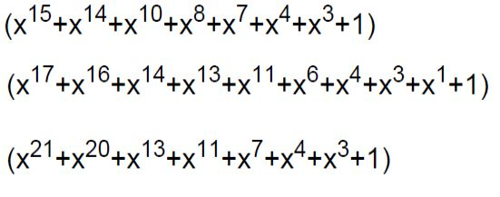
CRC in CAN FD
Based on the value of EDL and DLC bits, appropriate CRC polynomial is considered by transmitters and receivers.

Slide 56
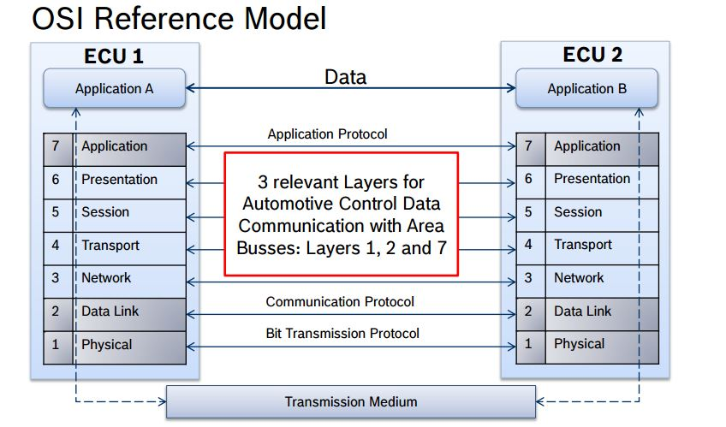
CAN- ISO OSI Reference Model

Slide 57
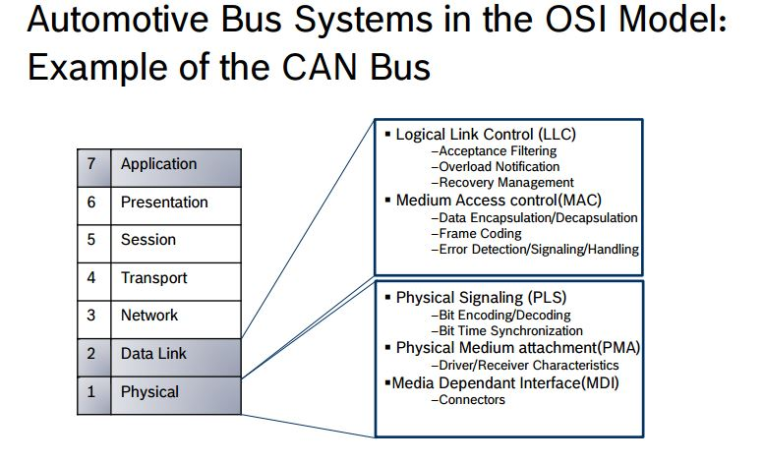
CAN- ISO OSI Reference Model

Slide 58
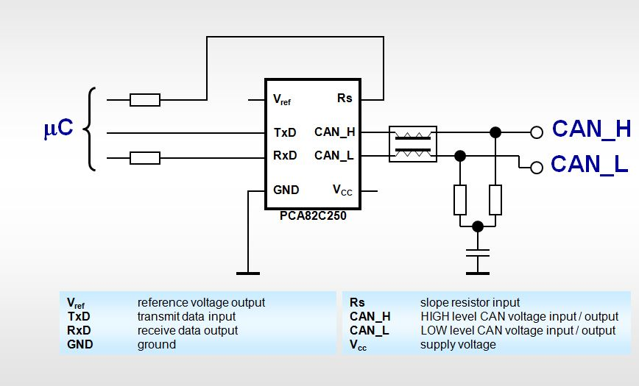
Transceiver- PCA 82C250

Slide 59
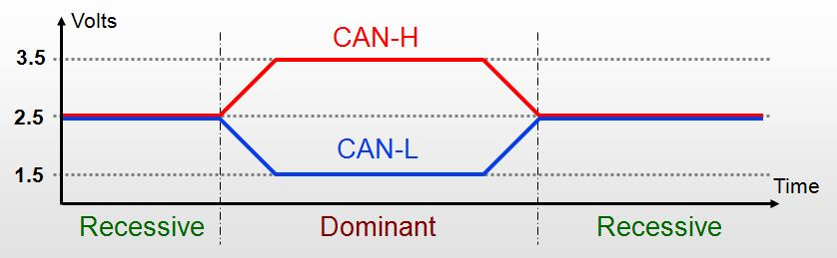
Signaling levels

Slide 60
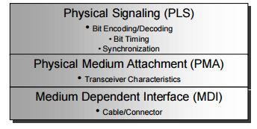
CAN Physical Layer
The CAN physical layer is divided into three parts:
The physical coding Signaling (PCS) implemented in the CAN controller chips
The physical medium attachment (PMA) specifying the transceiver characteristics, and
The MDI – specifies the cable and connector characteristics.

Slide 61
CAN -Physical and Data Link Layer
Physical Layer:
Bit encoding and decoding
Bit timing
Synchronization with CAN Bus
Data Link layer:
LLC(logical Link Control):
Message based protocol
Unique ID number
Accepts message by filtering
MAC Layer
Message framing , arbitration , error detection, acknowledgement

Slide 62
CAN Physical and Data Link Layer Layer
CAN controller incorporate logical link control and MAC medium access control of data link layer.
LLC allows filtering of messages by using unique ID on each message then MAC sub layer frames the message.
Once, framing is done it is followed by arbitration, error detection and acknowledgement that all comes under MAC sub layer of data link.
The frame is transferred to CAN trans-receiver, for encoding and decoding.
Finally CAN trans-receiver synchronizes with the CAN bus to send the message to another node.

Slide 63
Medium
Wire Medium
Voltage potential=recessive, grounded= dominant
Optical Medium
Light present= dominant, light absent=recessive.
Radio Medium
Carrier present= dominant, carrier absent=recessive

Slide 64
REFERENCES
Bosch, CAN (1991). Specification version 2.0. Published by Robert Bosch GmbH (September 1991)
Bosch, CAN with Flexible Data Rate (2012). Specification version 1.0. Published by Robert Bosch GmbH (April 2012)
http://www.ieee802.org/1/files/public/docs2013/new-tsn-diarra-osi-layers-in-automotive-networks-0313-v01.pdf
http://www.can-cia.org/can-knowledge/can/systemdesign-can-physicallayer/
http://www.eeherald.com/section/design-guide/esmod9.html
http://www.computer-solutions.co.uk/info/Embedded_tutorials/can_tutorial.htm

